Slide 1
California Public Expenditure Analysis
By: Roshaun Gregory

Slide 2
MOTIVATION?

Slide 3
Objectives
To show the total expenditure distribution among the four regions over the 10-year period.
To visually compare how the per capita expenditure varies across cities over time.
To show population trends for each of the four regions from 2013-2023.
To highlight the cities within each region that have the highest and lowest average per capita expenditures.

Slide 4
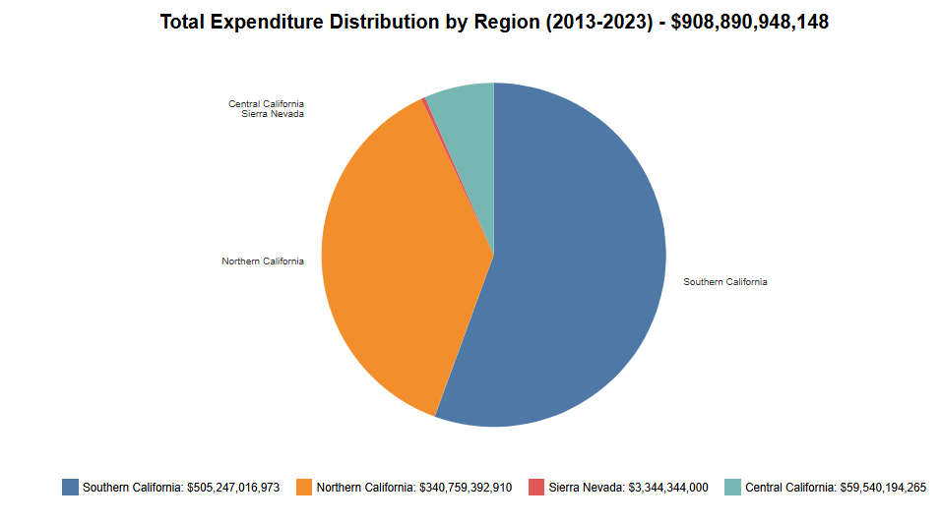

Slide 5
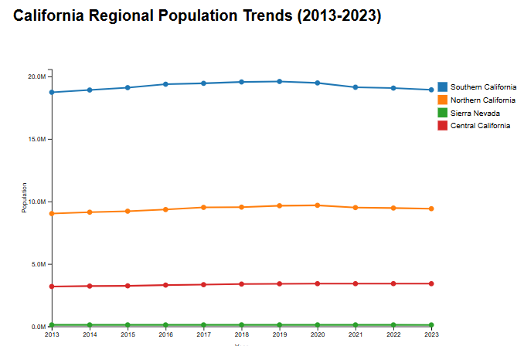

Slide 6
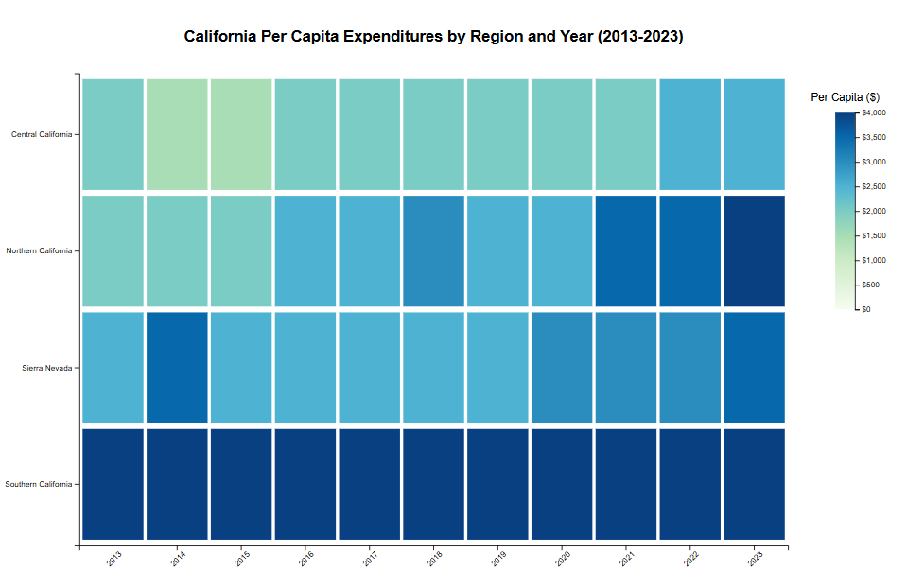

Slide 7
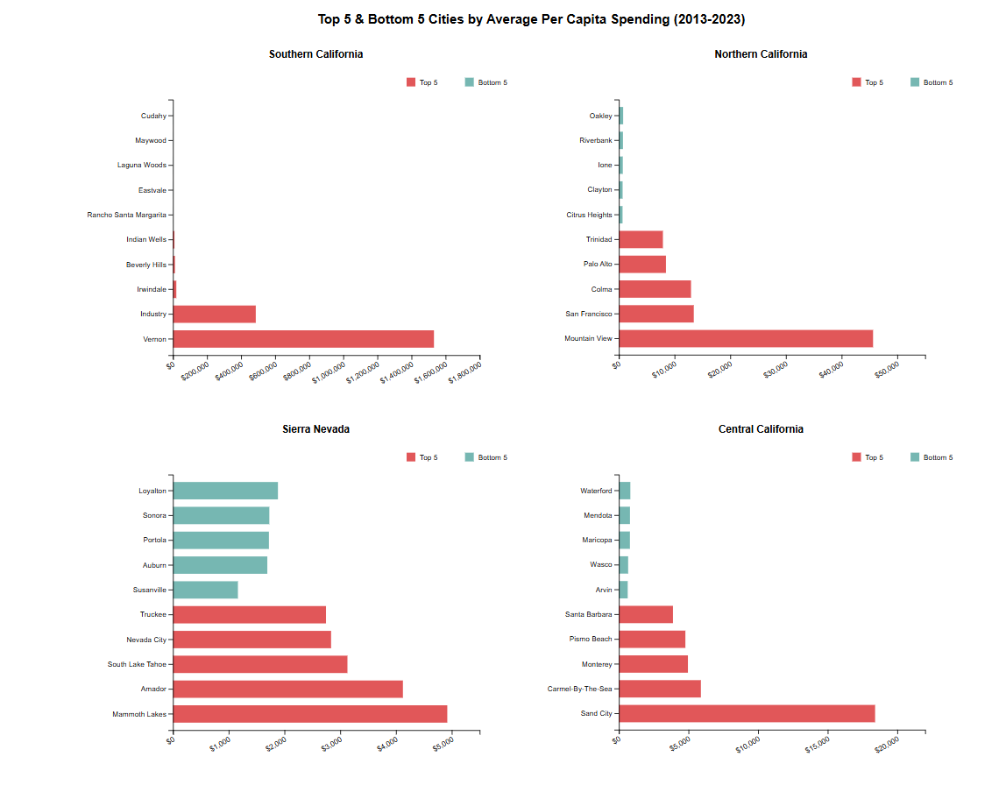

Slide 8
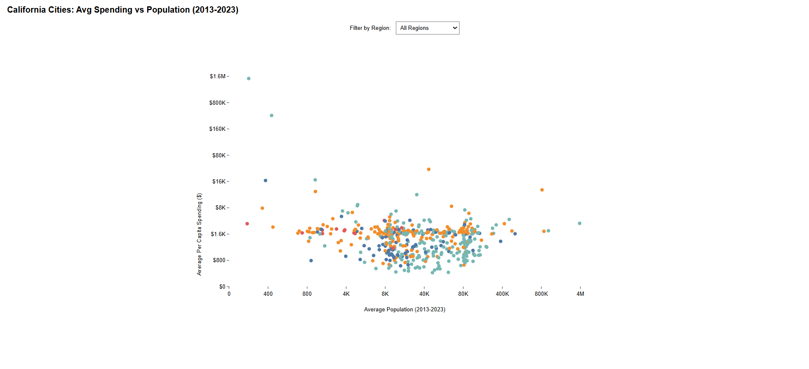

Slide 9
Link to demo: https:
//ripe-gelatinous-specialist.glitch.me/

Slide 10
Next Steps
Ensuring accurate values
Improving display

